Slide 1

Army Innovation Day 2026
SERVICE / COURAGE / RESPECT / INTEGRITY / EXCELLENCE
Market Briefing
10/07/2026
ARMY.GOV.au

Slide 2
Ms Kym Ridley
Deputy Director – Army Advanced Capabilities

Slide 3
Acknowledgement of Country
We acknowledge the Traditional Custodians of Country throughout Australia as the first innovators and experimenters of this land. We recognise their continuing connection to lands and waters, and we pay my respects to their Elders past and present. We celebrate their traditional knowledge, technology, culture, and experience that have, and will continue to, contribute to the rich diversity of the Australian innovation ecosystem.

Slide 4
Housekeeping
Submit questions through the Q&A panel; these will be addressed during designated question periods.
Please be respectful and professional in all interactions.
Ensure your name is displayed correctly for attendance and participation records.
Recording may be in progress. By remaining in the session, you consent to being recorded.
Please silence notifications and minimise background noise to avoid distractions.
Before We Begin
Check that you can see the presentation slides.
Familiarise yourself with the chat and Q&A functions.
Thank you for joining. We look forward to an engaging and productive session.

Slide 5
Introduction & format for session
Director Introduction and Update for AID
AID26 Intent and Proposed Plan
Q&A

Slide 6
Colonel Jake Penley
Director – Army Advanced Capabilities
Director’s Update – Changes to ‘RICO’ and Army Headquarters’ Land Capability Division
Autonomous Mass in the Littoral
Army Innovation Series Concept
AID26 Intent
    Focus on development
    Mutually beneficial value proposition
    Collaboration
    We need your help

Slide 7
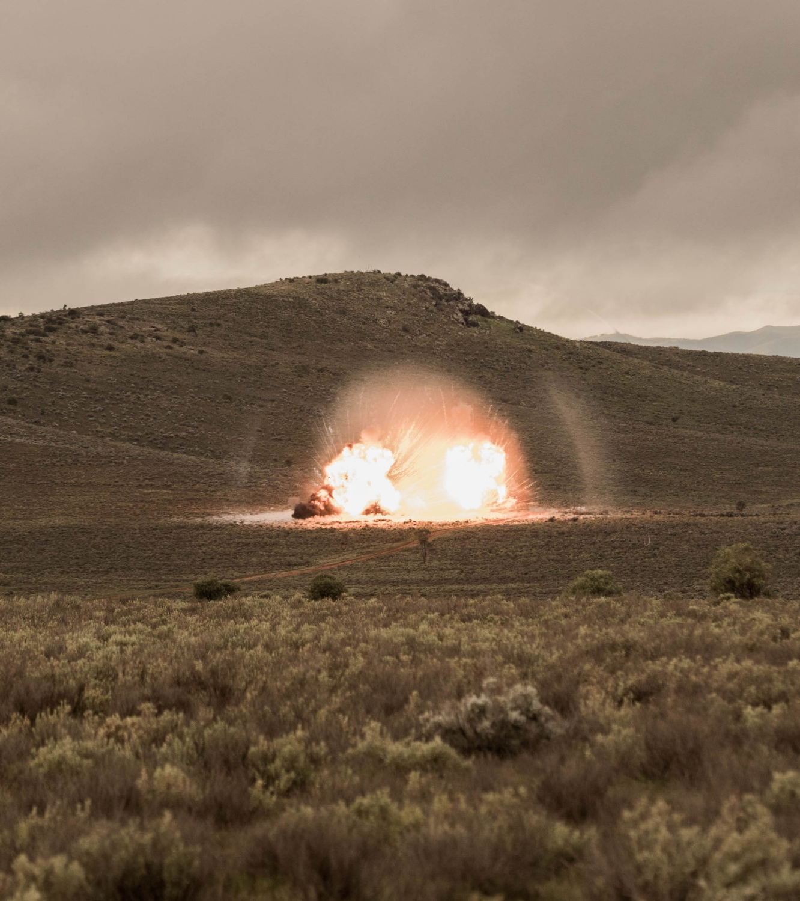
The Australian Army is seeking autonomous systems that operate collaboratively in contested littoral environments, while offering scalability and affordability, enabling small units to generate mass without exposing soldiers to enemy observation or direct fire.
Successful systems may deliver sense, strike, electronic warfare, mobility, and logistics effects, with a focus on human-on-the-loop operations.
AID 26 Challenge Statement

Slide 8
LTCOL Jordan Zahra
SO1 Trials and Exploration Lead

Slide 9
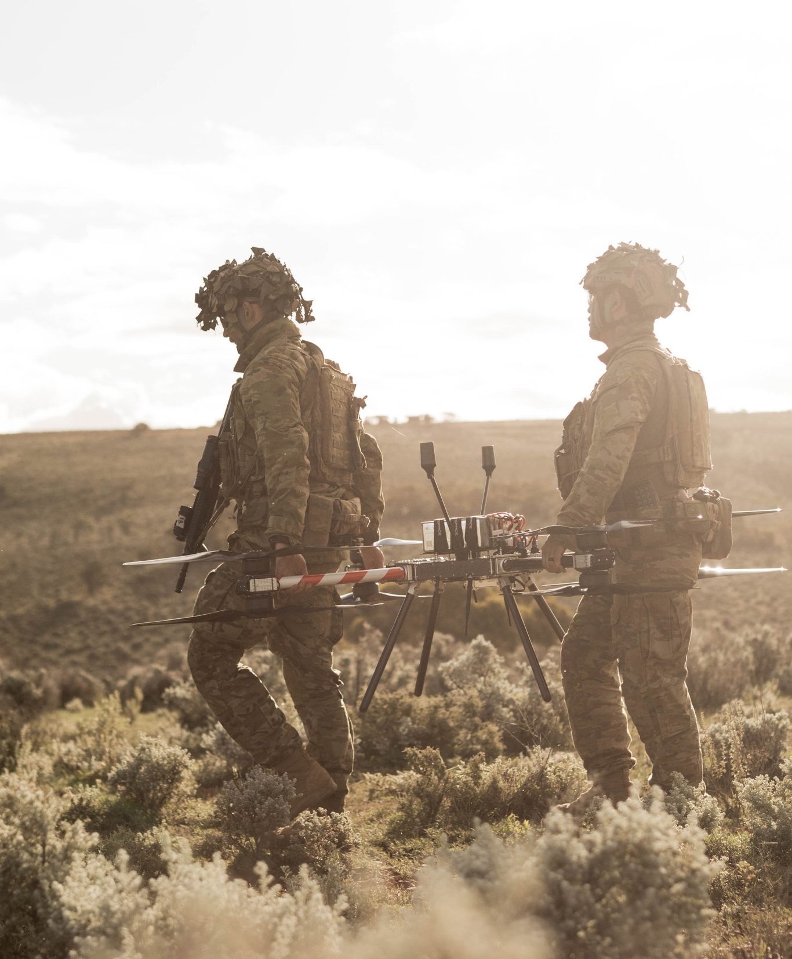
T&E Accountable Unit, accredited with Land T&E Agency
Routine T&E on robotics and autonomous systems
Work closely with 1 Armd Regt (the Combat Experimentation Group)
  Joint effort, G58, 1 Armd Regt, Defence Industry

Slide 10
Method of Test
Informal Liaison
Reporting
Understand your tech
Understand what your needs are
Determine if Army can meet needs
Execution
1 Armd Regt with G58 supporting
Final Prep
Logistics
Access
Travel
Land Forces International Land Defence Exposition 2026
6-8 Oct 26
Scoping
Assign a point of contact at 1 Armd Regt
Industry site visit by 1 Armd Regt / G58
Co-develop concept for test
Co-develop Measures of Effectiveness (MOEs) and Technical Performance Measures (TPMs)
Approvals, if required (Landworthiness, Airworthiness, spectrum)
Preparation
Familiarisation
Work-up
Gather data
Stretch goals
Warfighter Report
Daily feedback and planning, as required
IPC
August
MPC
September
FPC
October
TRR
November
Debrief
November

Slide 11
Technology Readiness Levels
TRL 1 | Basic principles observed
TRL 2 | Technology concept formulated
TRL 3 | Experimental proof of concept
TRL 4 | Technology validated in lab
TRL 5 | Technology validated in relevant environment
TRL 6 | Technology demonstrated in relevant environment
TRL 7 | System prototype demonstration in operational environment
TRL 8 | System complete and qualified
TRL 9 | Actual system proven in operational environment (competitive manufacturing in the case of key enabling technologies; or in space)

Slide 12
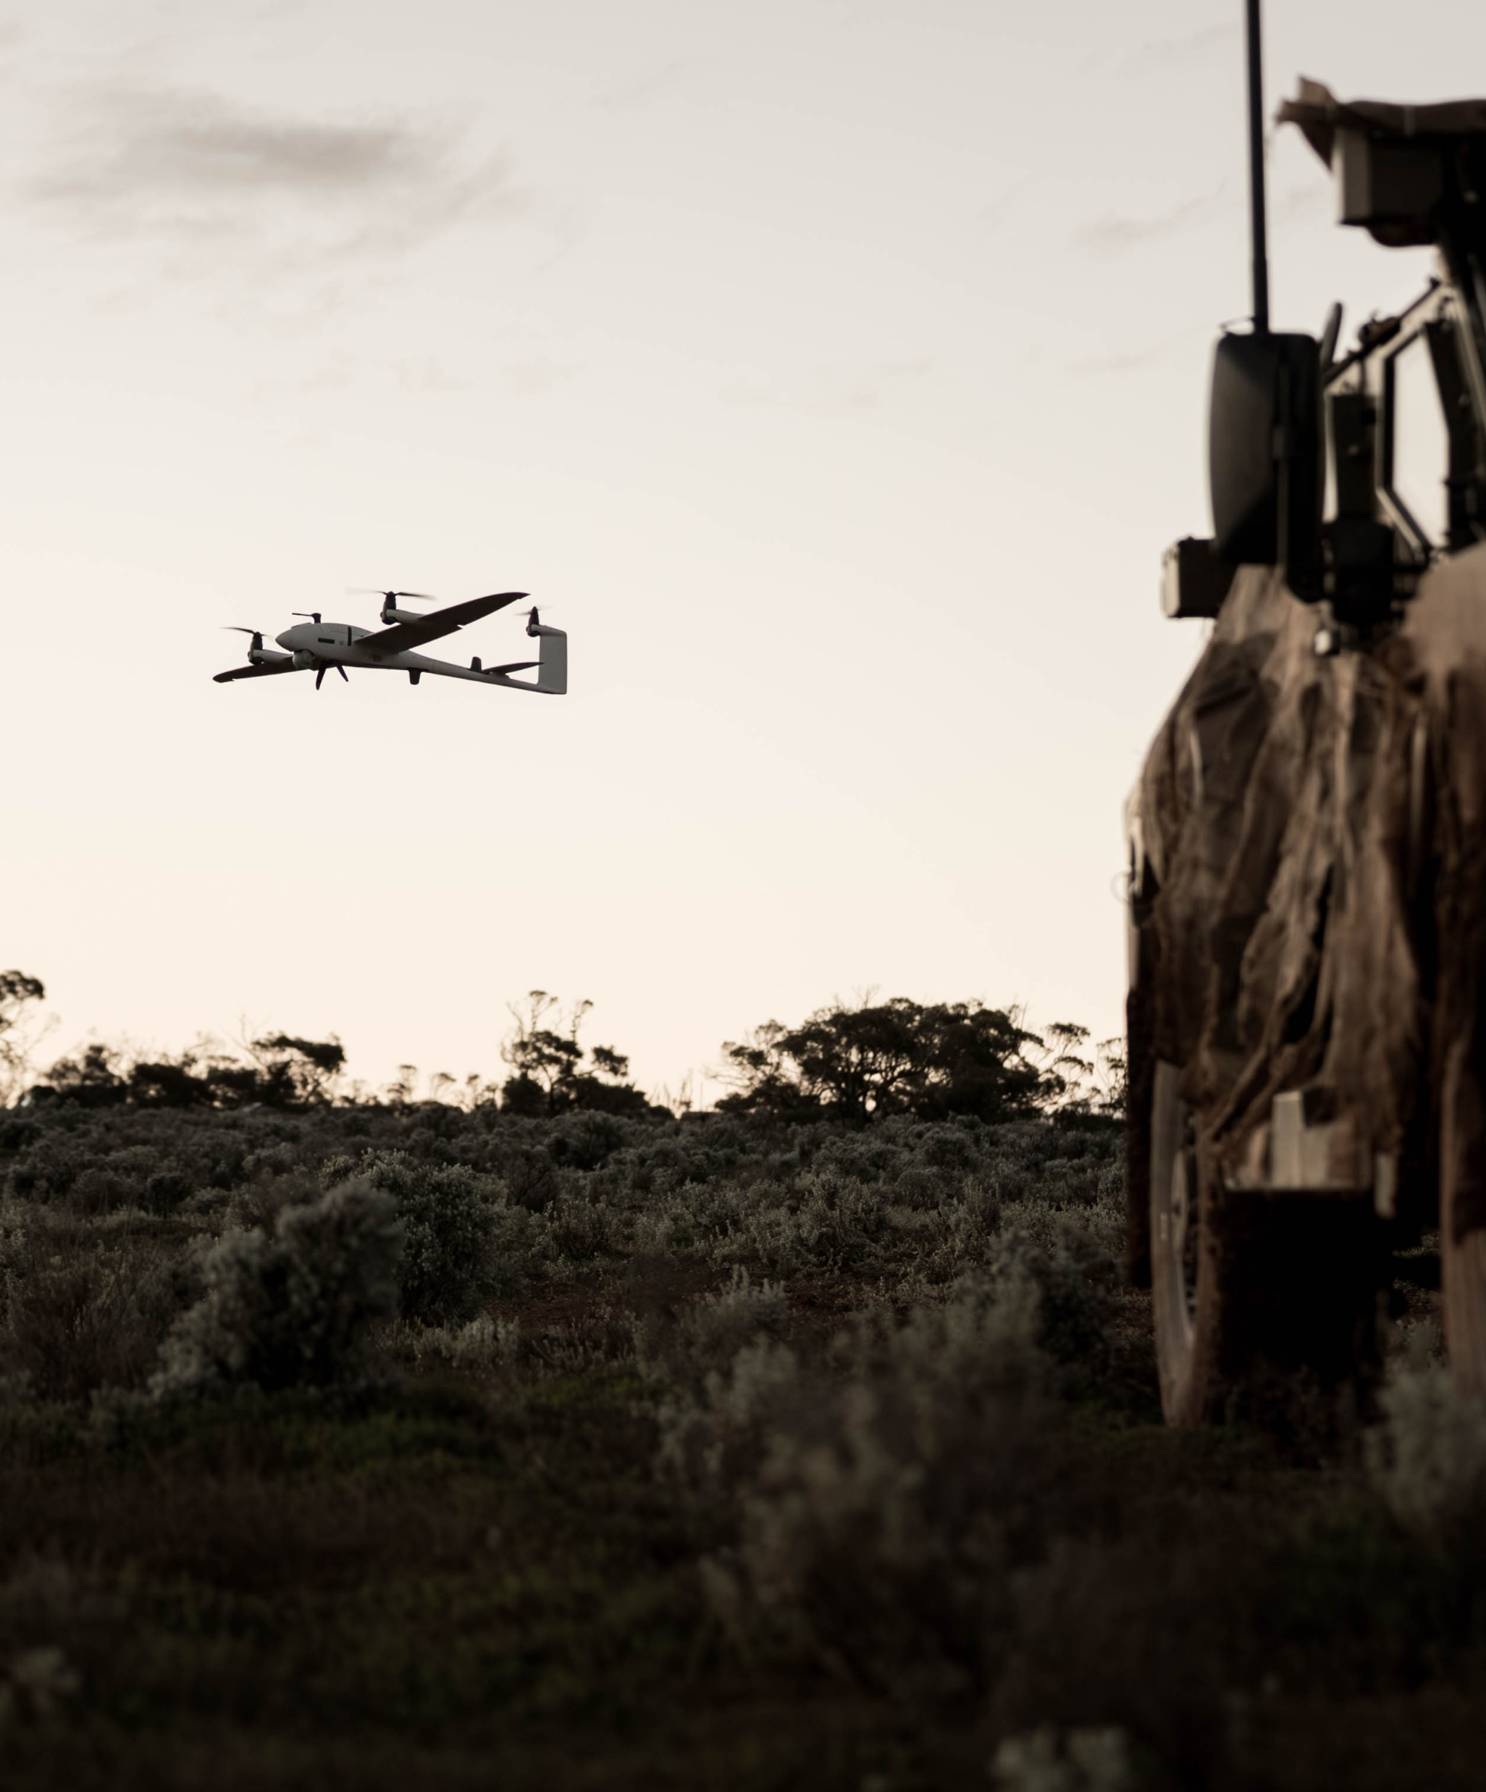
Technology Assessment Report, which will provide you with:
Formal Army feedback on your capability’s strengths, limitations, potential employment concepts and opportunities for future integration
Clear, actionable insight into how your systems performed in operationally relevant conditions.
Early validation against real warfighter requirements, reducing reliance on assumptions
Improved positioning for follow-on experimentation, procurement consideration, or transition into service.

Slide 13
AID26 Proposed Timeline
01 July 2026
RFI Released to Market
02 – 13 November 2026
Field Experimentation
August 2026
Successful Vendors notified
27 July 2026
RFI Submissions Close
06 – 08 October 2026
Land Forces

Slide 14
Please send all enquiries to army.innovation.day@defence.gov.au
And ensure AID26 is included in your subject line
All questions from today’s session will be released via an Addendum on AusTender.

Slide 15
AN ARMY FOR THE COMMUNITY
AN ARMY FOR THE NATION

